Slide 1


CMPE/SE 131
Software Engineering
February 16 Class Meeting
Department of Computer Engineering
San José State University
Spring 2017
Instructor: Ron Mak
www.cs.sjsu.edu/~mak

Slide 2
Project Phases
Requirements elicitation
Design
Implementation
Testing
Deployment
Maintenance
How do we accomplish these phases?

Slide 3
Ye Olde Waterfall Model
Requirements
Design
Implementation
Testing

Slide 4
The Waterfall Model, cont’d
Make sure each phase is 100% complete
and absolutely correct before proceeding
to the next phase.
Big Design Up Front (BDUF)
  Set requirements in stone before starting the design.
  Otherwise, you might waste design work on
  “incorrect” requirements.
  Spend extra time at the beginning to make sure that the requirements and design are absolutely correct.
  Source: Wikipedia article on “Waterfall Model”

Slide 5
The Waterfall Model, cont’d
The waterfall model has been mostly discredited.
  It doesn’t work!
  But it’s still commonly practiced.
Requirements
Design
Implementation
Testing

Slide 6
The Agile Manifesto for Software Development
We are uncovering better ways of developing software
by doing it and helping others do it.
Through this work we have come to value:
Individuals and interactions over processes and tools
Working software over comprehensive documentation
Customer collaboration over contract negotiation
Responding to change over following a plan
That is, while there is value in the items on
the right, we value the items on the left more.
Source: http://agilemanifesto.org/

Slide 7
Agile Software Development
Iterative and incremental development.
Each iteration is a “mini waterfall”:
  plan (with new requirements)
  refine design
  add new code
  unit and integration testing
Iterations are short:
weeks rather than months.
Iterations are sometimes called “sprints”.
  We do sprints, not marathons!
Requirements
Design
Implementation
Testing

Slide 8
Agile Software Development
The initial iteration produces a
conceptual design and a prototype.
Subsequent iterations refine the design and incrementally build the actual product.
Each subsequent iteration may also
include a prototype that is quickly produced (rapid prototyping).

Slide 9
Agile Software Development, cont’d
The initial iteration’s prototype and iterative development are the foundation for
Rapid Application Development (RAD) tools.
  Is Ruby on Rails RAD?
Agile methodologies range from
Extreme Programming (XP) to the
Rational Unified Process (RUP).

Slide 10
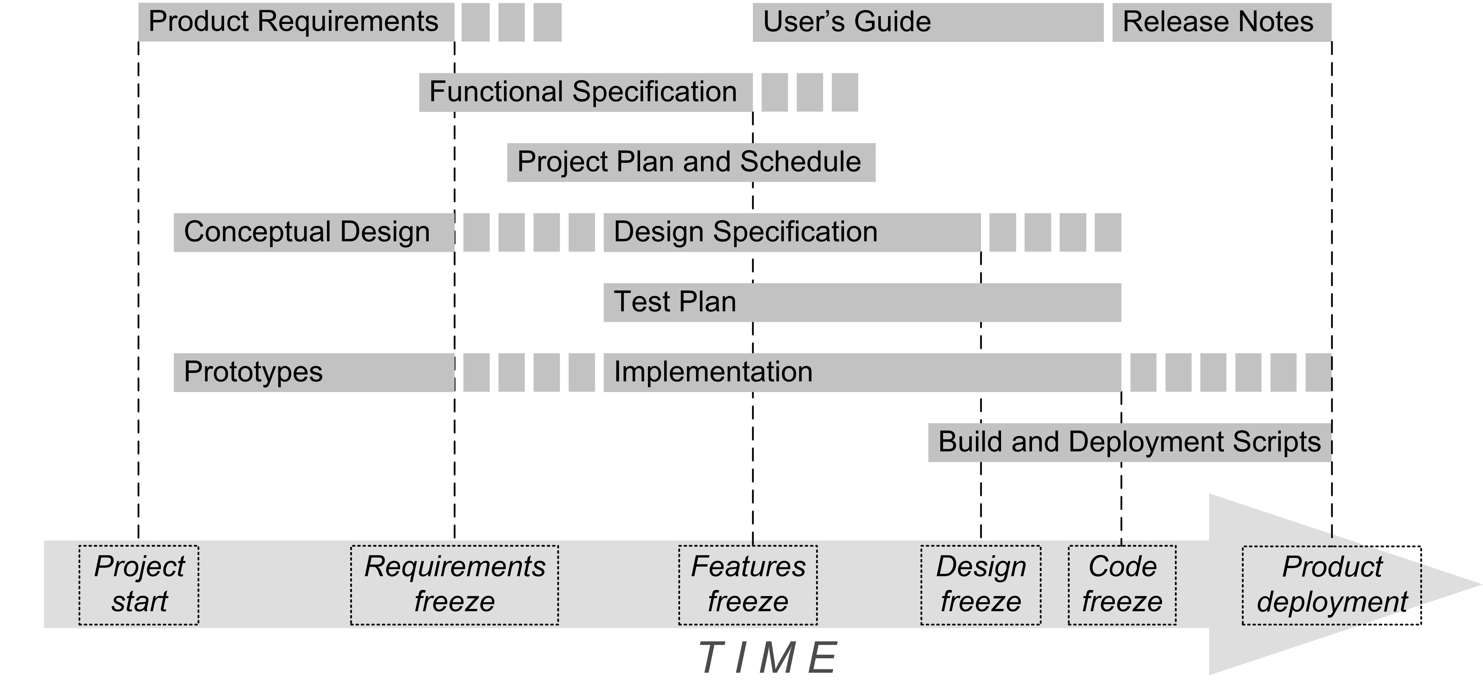
Project Phases, cont’d

Slide 11
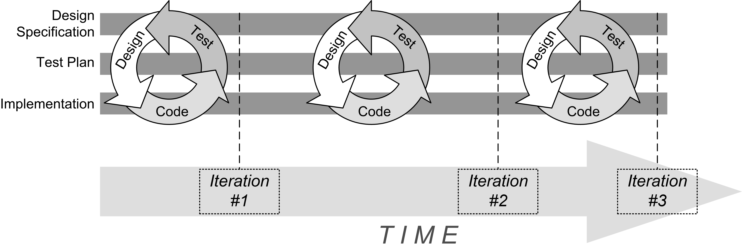
Project Phases, cont’d
Development is a series of iterations.
Each iteration is a “mini waterfall” consisting of design, code (implementation), and test.
Extreme programmers say: design, test, code

Slide 12
Requirements Elicitation
Requires communication between the developers and customers.
  Customer: users, clients, and stakeholders
  Client: who pays for your application
  Stakeholder: whoever else is interested in the success of your application (e.g., shareholders)
Customers can validate the requirements.
Creates a contract between the customer
and the developers.

Slide 13
Requirements Elicitation, cont’d
Result: a Functional Specification
written non-technically so that the
customers can read and understand it.

Slide 14
Bridging the Gap
Customers
  Have a general idea of what the system should do.
  Have little experience with software development.
  Are experts in their domain.
Software developers
  May have little knowledge of the application domain.
  Have experience with software technology.
  Are geeks with poor social skills.

Slide 15
Functional Requirements
What the system (the application)
shall be able to do or allow users to do.
  The application shall use GPS
  to determine the user’s location.
  The application must default to the option
  most frequently chosen by the users.
  The application must allow the user to choose between a text display or a graphics display.
  The user shall be able to make
  an online withdrawal or deposit.

Slide 16
Functional Requirements, cont’d
Describe the interactions between
the system and its environment
independent of its implementation.

Slide 17
Nonfunctional Requirements
Usability, reliability, performance, supportability, etc.
  The application must respond to user input
  within 5 seconds.
  The application shall run on the Windows, Mac,
  and Linux platforms.
  The new GUI must resemble the old GUI.
  Error messages shall be displayed in English
  and Spanish.
Constraints that the system must meet.

Slide 18
Requirements are Strong Statements
Use strong declarative statements
with “shall” and “must”.
  The application shall use GPS to determine
  the user’s location.
  The application must respond to user input
  within 5 seconds.

Slide 19
Requirements Must Be…
Complete
  Are all system features and constraints
  described by requirements?
Consistent
  No two requirements can contradict each other.
Clear
  Each requirement must be unambiguous.
Correct
  No errors in the requirements.

Slide 20
Requirements Must Be, cont’d
Realistic
  Can the system be implemented?
Verifiable
  Can the system be tested?
Traceable
  Can each requirement be traced
  to an application function or constraint?
  Can each application function or constraint
  be traced to a requirement?

Slide 21
Requirements Must Be, cont’d
Understandable
  Requirements must be written in non-technical jargon-free language that is meaningful to both
  the application’s developers and the application’s customers.

Slide 22
How to Get Requirements
Interview future users of your application.
Observe how the users currently work.
  Can you improve how they currently do things?
  Can you make them more productive?
Stated requirements
  The customer tells you want he or she wants.
Implied requirements
  What do you think the customer wants?

Slide 23
How to Get Requirements, cont’d
Customers don’t always know what they want.
They will know more after you
show them a prototype.
They will change their minds.
It’s an iterative process!

Slide 24
How to Get Requirements, cont’d
If the developers force the customers
to come up with the requirements too soon, they may make something up!
Such requirements will most likely be
wrong or incomplete and lead you astray.

Slide 25
Use Cases
A use case describes a single task that your application must allow an actor to accomplish
or a single goal that an actor must achieve.
Actors are external agents that interact or communicate with the system.
  actors = role abstractions
  An actor can be a person or another system.

Slide 26
Use Cases, cont’d
Uses cases are an important way for the developers of a software application and its customers to communicate:
  What functionality the application must have.
  What steps to achieve the functionality.
An application’s use cases capture the bulk
of the customer’s understanding of what the application is supposed to do.

Slide 27
Use Cases, cont’d
A use case includes:
  A complete sequence of actions or events
  from the point of view of an actor.
  A primary sequence
  Alternate sequences (“exception paths”).
A sequence is triggered by an actor.
Focus on what the system must do,
not how to do it.
A use case treats the system as a “black box”.

Slide 28
Example: Bank ATM System
system
Start up
ATM
system boundary
actor
Shut down
ATM
use cases
Operator
Log in
customer
interaction
When you draw a
use case diagram,
do not include the
red labels and arrows.
Log out
customer
Withdraw
cash
Customer
Display
balance
UML use case diagram
Bank

Slide 29
Example Use Case Description
Name: Withdraw Cash
Goal: Customer withdraws cash from ATM.
Summary: A customer who has logged in can withdraw up to $500 cash in $20 bills.
Actors: The customer and the bank

Slide 30
Example Use Case Description, cont’d
Preconditions:
  The ATM has been started up.
    See use case “Start up ATM”.
  The customer has inserted a valid bank card.
  The customer has entered a correct PIN.
Trigger: The customer selects the
“Withdraw Cash” option.

Slide 31
Example Use Case Description, cont’d
Primary sequence:
  The system prompts the customer for the amount.
  The customer chooses from a list of amounts
  or enters a amount.
  The customer confirms and submits the amount.
    (The ATM communicates with the bank
    to check the customer’s account.)
  The system dispenses the amount in $20 bills.
    (The bank deducts the amount
    from the customer’s balance.)
  The system displays the customer’s balance
    See use case “Display balance”.
At most about 10 steps.
Another use case.

Slide 32
Example Use Case Description, cont’d
Alternate sequences:
  3.1 The customer entered an amount
  that is not a multiple of $20.
    3.1.1 The system displays a message to the customer .
    3.1.2. The system prompts the customer for a new amount.
  3.2 The customer’s bank balance is insufficient.
    3.2.1 etc.

Slide 33
Example Use Case Description, cont’d
Postconditions:
  The customer receives the desired amount of cash.
    The amount is deducted from the customer’s account.
    The customer sees the new account balance.
  OR: The customer receives no cash.
    The customer’s account is unchanged.
What must be true after the use case is done.

Slide 34
Example Use Case Description, cont’d
Nonfunctional requirements:
  The system responds to each customer input
  within 15 seconds.
  The system displays messages in either
  English or Spanish.
Glossary
  customer = a person who wants to withdraw cash from the ATM.
  bank = a system that maintains customer accounts and balances.
  etc.

Slide 35
Use Case Description Guidelines
Use case names should be verb-object.
  Each name should describe an achievable goal or doable task (e.g., “Withdraw Cash”).
Keep use cases short, simple, and informal.
  Clients and users need to understand them.
  No GUI or implementation details.

Slide 36
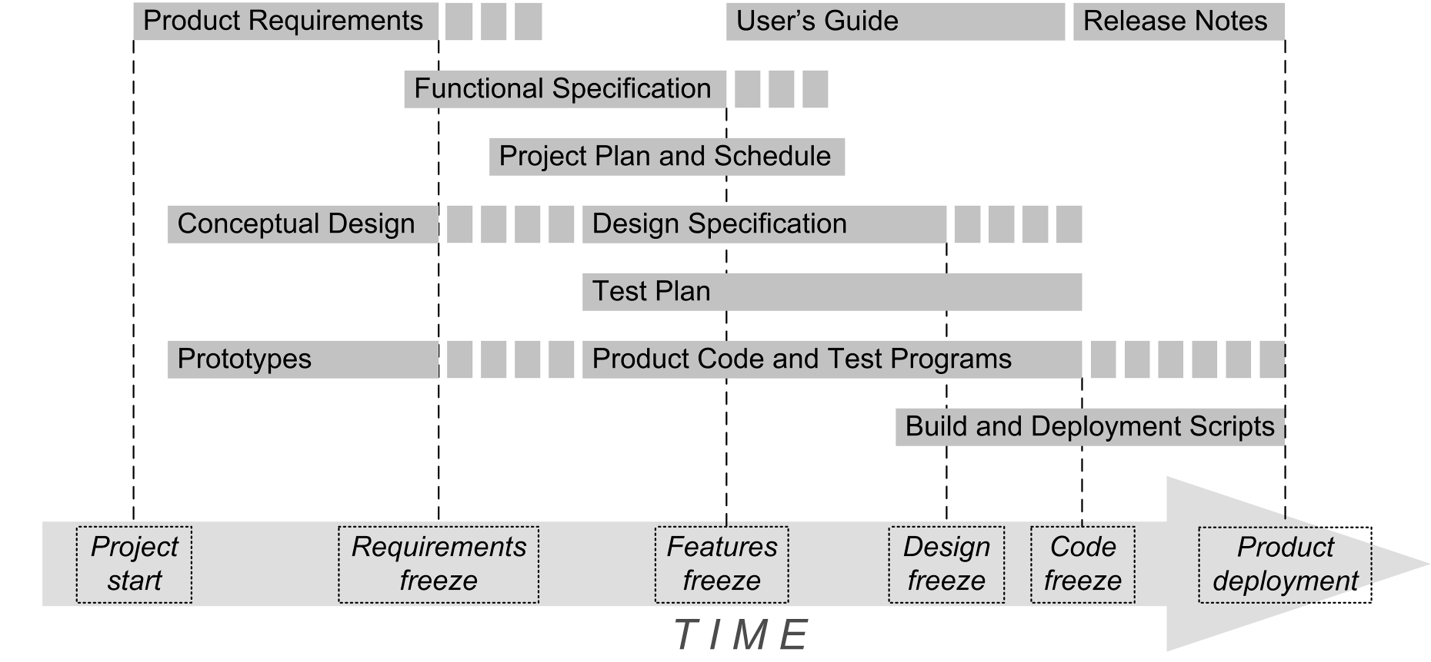
The Functional Specification
Product name
Clear problem
statement
  What is the
  problem?
Objectives
  What is your
  application
  supposed to
  accomplish?
Functional requirements
Nonfunctional requirements
Use cases
Primary contents of a
Functional Specification

Slide 37
Assignment #3: Functional Specification
Each project team creates the first draft of the
Functional Specification for its web application.
  Product name
  Problem statement
  Objectives
  6 Functional requirements
  4 Nonfunctional requirements
  Use case diagram with 6 use cases
  Use case descriptions of 3 of your use cases
Later assignments will add a conceptual design and screen mockups.

Slide 38
Assignment #3, cont’d
Each team turns in one Functional Specification.
  Microsoft Word document or PDF
Canvas: Assignment #3
Due Friday, February 24 at 11:59 PM.
Use case description form:
http://www.cs.sjsu.edu/~mak/CMPE131/assignments/2/UseCaseForm.docx

