Slide 1


CMPE/SE 131
Software Engineering
February 9 Class Meeting
Department of Computer Engineering
San José State University
Spring 2017
Instructor: Ron Mak
www.cs.sjsu.edu/~mak

Slide 2
Eclipse Ruby Plugin
Ruby DLTK
  Dynamic Languages Toolkit
See
https://marketplace.eclipse.org/content/ruby-dltk

Slide 3
Still Having Windows Installation Problems?
First try http://www.cs.sjsu.edu/~mak/CMPE131/RoR_Rev1.0.3_26012017.pdf
Then try: http://railsinstaller.org/en

Slide 4
The Comments Controller
Generate a new controller for comments:
~/ruby/code/blog: bin/rails generate controller comments
Running via Spring preloader in process 1782
create app/controllers/comments_controller.rb
invoke erb
create app/views/comments
invoke test_unit
create test/controllers/comments_controller_test.rb
invoke helper
create app/helpers/comments_helper.rb
invoke test_unit
invoke assets
invoke coffee
create app/assets/javascripts/comments.coffee
invoke scss
create app/assets/stylesheets/comments.scss
empty controller
empty directory

Slide 5
The Comments Controller, cont’d
class CommentsController < ApplicationController
def create
@post = Post.find(params[:post_id])
if @post.comments.create(comment_params)
redirect_to @post,
notice: 'Comment was successfully created.'
else
redirect_to @post,
alert: 'Error creating comment'
end
end
private
def comment_params
params.require(:comment).permit(:author, :body)
end
end
Strong parameters

Slide 6
Path and URL Helper Functions
Use the helpers in your controller and view code instead of hardcoding paths and URLs.
Path helpers | URL helpers
post_path | post_url
post_path(id) | post_url(id)
new_post_path | new_post_url
edit_post_path(id) | edit_post_url(id)
post_comments_path(id) | post_comments_url(id)
login_path | login_url
logout_path | logout_url
root_path | root_url

Slide 7
Path and URL Helper Functions, cont’d
Test the helper functions:
irb(main):023:0> app.posts_path
=> "/posts"
irb(main):024:0> app.posts_url
=> "http://www.example.com/posts"
irb(main):025:0> app.post_path(3)
=> "/posts/3"
irb(main):026:0> app.new_post_url
=> "http://www.example.com/posts/new"
irb(main):027:0> app.post_comments_path(4)
=> "/posts/4/comments"
irb(main):028:0> app.login_path
=> "/login"
irb(main):029:0> app.root_url
=> "http://www.example.com/"

Slide 8
More on Routing
Several tutorials on the web about Rails routing.
  Google “rails routing tutorial”

Slide 9
Database Actions and HTTP Verbs
Mapping between database CRUD actions
and HTTP verbs:
A web browser is only able to issue
GET and POST requests.
Therefore, Rails fakes the PATCH and DELETE requests.
Database action | HTTP verb
create | POST
read | GET
update | PATCH
delete | DELETE

Slide 10
Default RESTful Actions
Rails uses REST, which expands the read database action (HTTP GET) into four
RESTful actions:
RESTful action | HTTP verb | Description
index | GET | List all records.
show | GET | Show one record.
new | GET | Show a form to create a new record.
edit | GET | Show a form to edit an existing record.
create | POST | Create a new record.
update | PATCH | Update an existing record.
destroy | DELETE | Delete a record.

Slide 11
Display the Application’s Routes
The combination of the HTTP verb and the
URI pattern determines the controller action.
~/ruby/code/blog: bin/rake routes
Running via Spring preloader in process 1581
Prefix Verb URI Pattern Controller#Action
post_comments POST /posts/:post_id/comments(.:format) comments#create
posts GET /posts(.:format) posts#index
POST /posts(.:format) posts#create
new_post GET /posts/new(.:format) posts#new
edit_post GET /posts/:id/edit(.:format) posts#edit
post GET /posts/:id(.:format) posts#show
PATCH /posts/:id(.:format) posts#update
PUT /posts/:id(.:format) posts#update
DELETE /posts/:id(.:format) posts#destroy
login GET /login(.:format) user_session#new
POST /login(.:format) user_session#create
logout DELETE /logout(.:format) user_sessions#destroy
root GET / posts#index

Slide 12
The Route Prefix
~/ruby/code/blog: bin/rake routes
Running via Spring preloader in process 1581
Prefix Verb URI Pattern Controller#Action
post_comments POST /posts/:post_id/comments(.:format) comments#create
posts GET /posts(.:format) posts#index
POST /posts(.:format) posts#create
The route prefix determines which Rails
path and URL helper function to use.
A URL helper generates a URL that includes the protocol, server, port, and path.
A path helper only generates the path.
Use the helpers in your controller and view code instead of hardcoding paths and URLs.

Slide 13
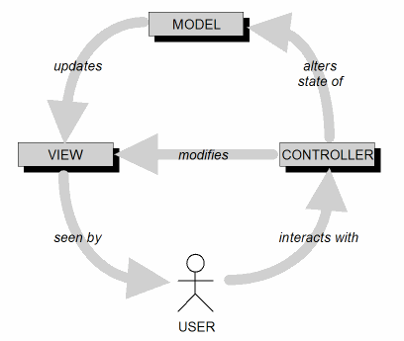
Views
The view is your application’s user interface.
Presents a user-friendly visual rendition
of the application’s model.

Slide 14
Embedded Ruby
An embedded Ruby .erb file is a template from which Rails generates an HTML page.
The HTML page contains embedded Ruby code that executes before the page is sent
to the client.
The embedded Ruby code dynamically creates content which replaces the embedded code within the HTML page.

Slide 15

Output Tags
Output tags <%= and %>.
  Example: app/views/post/show.html.erb
<p id="notice"><%= notice %></p>
<p>
<strong>Title:</strong>
<%= @post.title %>
</p>
<p>
<strong>Body:</strong>
<%= @post.body %>
</p>
<%= link_to 'Edit', edit_post_path(@post) %> |
<%= link_to 'Back', posts_path %>
Path helpers

Slide 16
Control Flow Tags
Tags <% and %> enclose Ruby code that executes to do control flow.
  Example: app/views/post/index.html.erb
<tbody>
<% @posts.each do |post| %>
<tr>
<td><%= post.title %></td>
<td><%= post.body %></td>
<td><%= link_to 'Show', post %></td>
<td><%= link_to 'Edit', edit_post_path(post) %></td>
<td><%= link_to 'Destroy', post, method: :delete,
data: { confirm: 'Are you sure?' } %></td>
</tr>
<% end %>
</tbody>

Slide 17
Helpers
Ruby methods that simplify your view code.
  create links
  format numbers
  other common tasks
Avoid having too much embedded code.
Write your own helpers.

Slide 18
Helpers, cont’d
URL helpers
  Example:
  generates
Number helpers
  number conversion
  number formatting
link_to 'Show', post
<a href="/posts/1">Show</a>

Slide 19
Write Your Own Helpers
Put in app/helpers
  Example: app/helpers/application_helper.rb
module ApplicationHelper
def friendly_date(d)
d.strftime("%B %e, %Y")
end
end
friendly_date Time.new(2017, 2, 9)

Slide 20
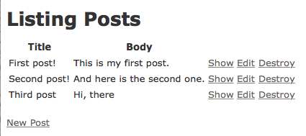
Index Page Generation Example
The index page is dynamically generated.

Slide 21
Index Page Generation Example, cont’d
  app/views/posts/index.html.erb
<p id="notice"><%= notice %></p>
<h1>Listing Posts</h1>
<table>
<thead>
<tr>
<th>Title</th>
<th>Body</th>
<th colspan="3"></th>
</tr>
</thead>
...

Slide 22
Index Page Generation Example, cont’d
  app/views/posts/index.html.erb
...
<tbody>
<% @posts.each do |post| %>
<tr>
<td><%= post.title %></td>
<td><%= post.body %></td>
<td><%= link_to 'Show', post %></td>
<td><%= link_to 'Edit', edit_post_path(post) %></td>
<td><%= link_to 'Destroy', post, method: :delete,
data: { confirm: 'Are you sure?' } %></td>
</tr>
<% end %>
</tbody>
</table>
<br>
<%= link_to 'New Post', new_post_path %>
Instance variable @posts was initialized
by the Post controller’s index action.
def index
@posts = Post.all
end
Fake the DELETE request.

Slide 23
Layouts
Good UI design includes having a consistent layout for your application’s web pages.
  common headers, footers.
  common page structure
  etc.
A Rails layout is a file containing the common HTML code for every application page.

Slide 24
Layouts, cont’d
  app/views/layouts/application.html.erb
<!DOCTYPE html>
<html>
<head>
<title>Blog</title>
<%= stylesheet_link_tag 'application', media: 'all',
'data-turbolinks-track' => true %>
<%= javascript_include_tag 'application',
'data-turbolinks-track' => true %>
<%= csrf_meta_tags %>
</head>
<body>
<%= yield %>
</body>
</html>
Change to default
for Windows.
Assets such as JavaScript and CSS files
are kept in app/assets.
Security helper to protect against
cross-site request forgery (CSRF).

Slide 25
Partials
A partial is a snippet of view code
that is “included” by other view code.
This allows the same display elements to be repeated on different pages.
  By convention, names of partial start with _
  Example:
  app/views/comments/_comment.html.erb
<p><strong><%= comment.author %></strong> said:
<br>
<%= comment.body %>

Slide 26
Displaying Comments
Display the comments for a post at the bottom of the page that shows that post.
app/views/posts/show.html.erb
<p id="notice"><%= notice %></p>
<h2><%= @post.title %></h2>
<p><%= @post.body %></p>
<%= link_to 'Edit', edit_post_path(@post) %> |
<%= link_to 'Back', posts_path %>
<h3>Comments</h3>
<%= render @post.comments %>
“Include” partial _comment.html.erb

Slide 27
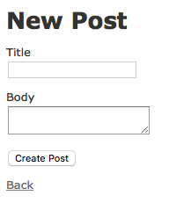
Forms
HTML forms enable users to submit data to the application code running on the web server.
  Create the form with a partial so it can be reused.

Slide 28
Post Form
  app/views/posts/_form.html.erb
<%= form_for(@post) do |f| %>
<% if @post.errors.any? %>
<div id="error_explanation">
<h2><%= pluralize(@post.errors.count, "error") %>
prohibited this post from being saved:
</h2>
<ul>
<% @post.errors.full_messages.each do |message| %>
<li><%= message %></li>
<% end %>
</ul>
</div>
<% end %>
...
Bind a form to a model.
Check for and handle form errors.

Slide 29
Post Form, cont’d
  app/views/posts/_form.html.erb
<%= form_for(@post) do |f| %>
...
<div class="field">
<%= f.label :title %><br>
<%= f.text_field :title %>
</div>
<div class="field">
<%= f.label :body %><br>
<%= f.text_area :body %>
</div>
<div class="actions">
<%= f.submit %>
</div>
<% end %>

Slide 30
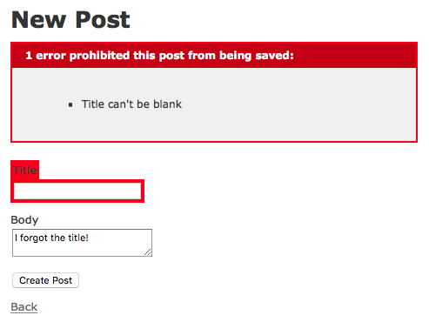
Form Errors
Try to create a post with an empty title.

Slide 31
Comment Form
Add the form to create comments for a post
at the bottom of the page that shows that post.
app/views/posts/show.html.erb
...
<%= form_for [@post, @post.comments.build] do |f| %>
<div class='field'>
<%= f.label :author %><br>
<%= f.text_field :author %>
</div>
<div class='field'>
<%= f.label :body %><br>
<%= f.text_area :body %>
</div>
<div class='actions'>
<%= f.submit %>
</div>
<% end %>

